Slide 1
Automation Kickstart
How to get on that Bandwagon

Slide 2
About
Jeff Tehovnik
https://github.com/Emb3r5/AutomationResources
Senior Security Engineer focused on Automation/Virtualization/Cloud Infrastructure & Automation. Also interested in Ethical Hacking on-the-side.
Currently Sub-Instructor for Cybersecurity Bootcamp at University of Richmond
Spare time = Family, Running, Reading, Movies & etc.

Slide 3
Why Automate?
Increased Security Posture (Patching, Configuration Management)
Increased Efficiency
Less Stress with consistent configurations
Increased Speed
Decreased workforce demands
Because the CIO read about it in a Magazine and now wants to

Slide 4
DevOps with CI/CD Pipeline
Fancy way of saying there’s an Automated Process to Build, Test, and Deploy
Integrations between Code Repo (Github) <-> Build Server (Jenkins) <-> Central Repository (Artifactory).
There are many more integrations available for the Pipeline, such as Security Testing (DevSecOps)

Slide 5
There are other “means” to Automation

Slide 6
Automation Technologies
Terraform
Vagrant
Fabric
Python(or other) Scripts
Ansible/Salt/Puppet/Chef
Postman Scripts
Powershell Scripts (Got Remote PS?)
Docker/Kubernetes
Use CURL statements and just up-arrow and modify parameters/values
CSP Tool Suite (I.E. Azure ARM templates, CloudFormation, etc.)
MAC Automator
GitLab Integrations

Slide 7
Start Here: Deciding What to Automate?
Option A:
Start Small, get some quick wins, build up confidence and capabilities
Option B:
Prioritize processes that are resource intensive
Option C:
Develop and automate something new

Slide 8
Template your Automation
Template should include:
Current Manual Process (If one exists) from End to End
Variables (IP Addresses, etc.)
Credential Handling (Vault, AuthZ, AuthN, etc.)
Technologies (Reference Slide 5)
Note: Multiple Different Technologies add complications and increase agility
Pseudo Code

Slide 9
Manual Process
Define the current process to accomplish the task. I.E.
Login.
Check System NTP and DNS settings.
-Fix if broken.
Log activities.
Logout

Slide 10
Variables
This is all the data needed at run time that isn’t pre-defined.
Variables make automation portable/reusable.
Variables can be input by hand at runtime (I.E. as an argument to called script)
Development may be incorporated to pull information, usually by querying another system (I.E. Query IPAM tool to get IP Address)
Variables may be pre-defined in code, and chosen at runtime

Slide 11
Credential Handling
Decide how auth will be handled (at least initially) before coding starts
Lots of options: Hardcoded Passwords (whaaaa) to Vault/IAM options
Follow SDLC best practices. I.E. lower protections for DEV environments, Higher for PROD
Likely will mature as Automation matures. Document if this is so.

Slide 12
Technologies
Survey available options (Slide 5). Leverage institutional knowledge.
Research (Google) for possible solutions or ideas
Weigh all team members skill sets
Select one (or more)

Slide 13
Pseudo Code
High Level Steps - Independent of the Technology
I.E.
Authenticate
Check Dependencies
Fix if broken, Log Event
Add new DNS Server to Configuration
Verify
Log/Alert if Failure
Clean-up

Slide 14
Examples

Slide 15
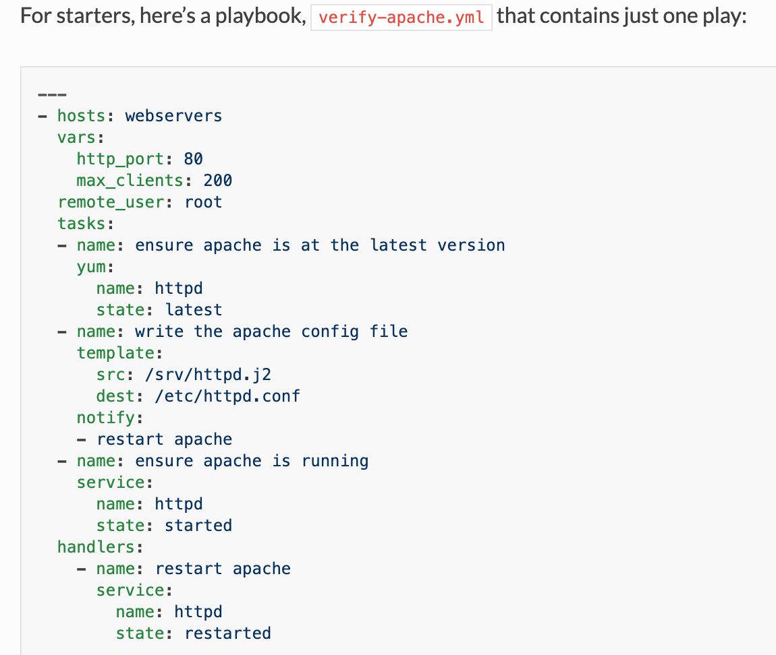
Ansible
https://docs.ansible.com/ansible/latest/user_guide/playbooks_intro.html#about-playbooks

Slide 16
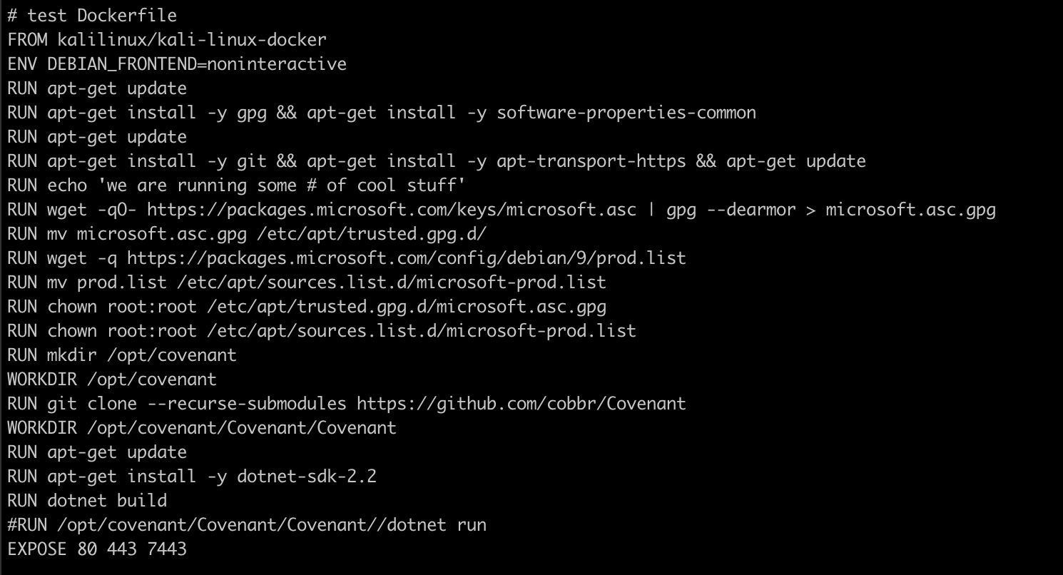
Covenant Dockerfile docker build -t kali:covenant ./ && docker images && docker run -it -p 7443:7443 -p 80:80 -p 443:443 --name kali3 kali dotnet run && MYID=$(docker ps -a | grep "kali3" | cut -d' ' -f 1) && docker inspect -f '{{range .NetworkSettings.Networks}}{{.IPAddress}}{{end}}' $MYID; unset MYID https://www.docker.com/sites/default/files/d8/2019-09/docker-cheat-sheet.pdf

Slide 17
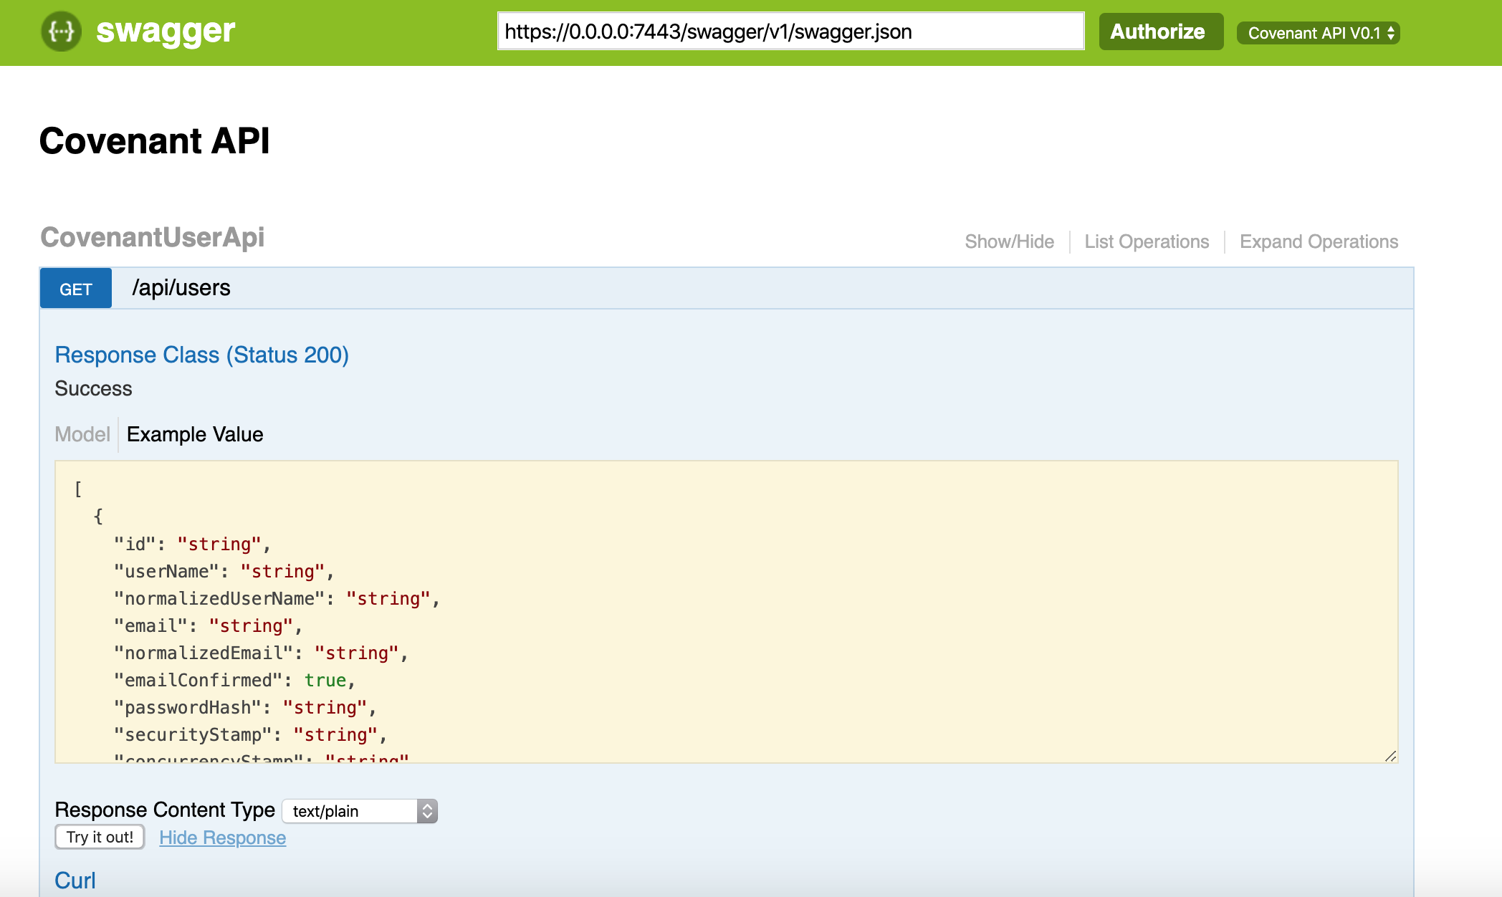
Swagger (API)

Slide 18
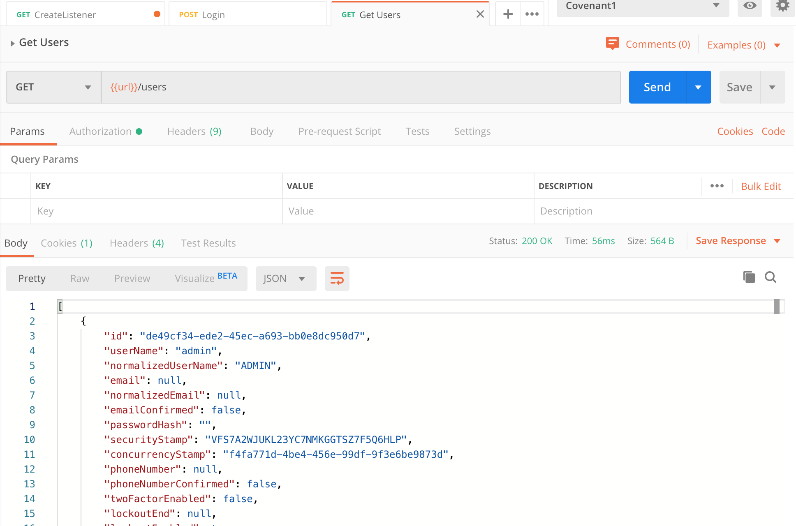
Postman
https://medium.com/@codebyjeff/using-postman-environment-variables-auth-tokens-ea9c4fe9d3d7

Slide 19
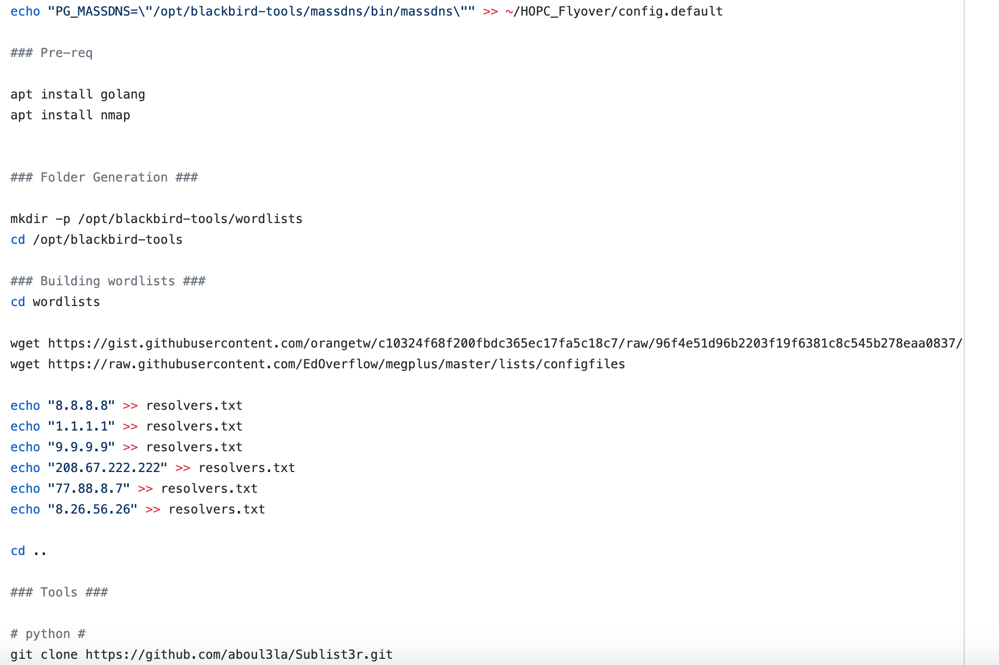
https://github.com/S4R1N/BlackBird

Slide 20
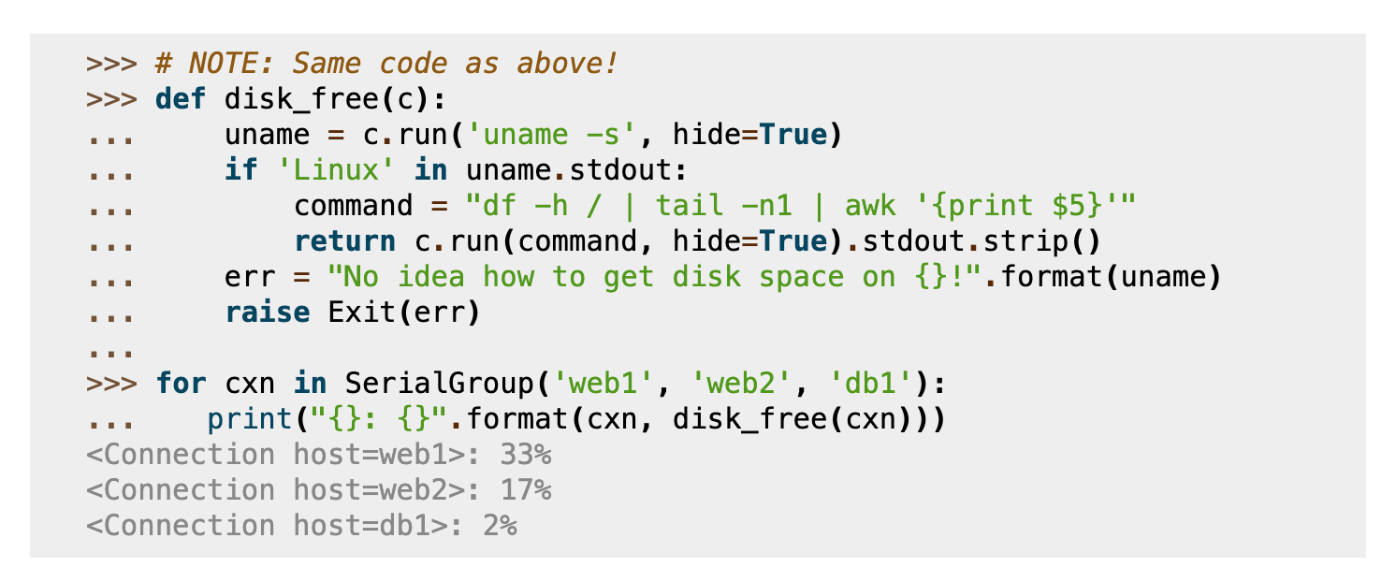
Fabric - http://www.fabfile.org/

Slide 21
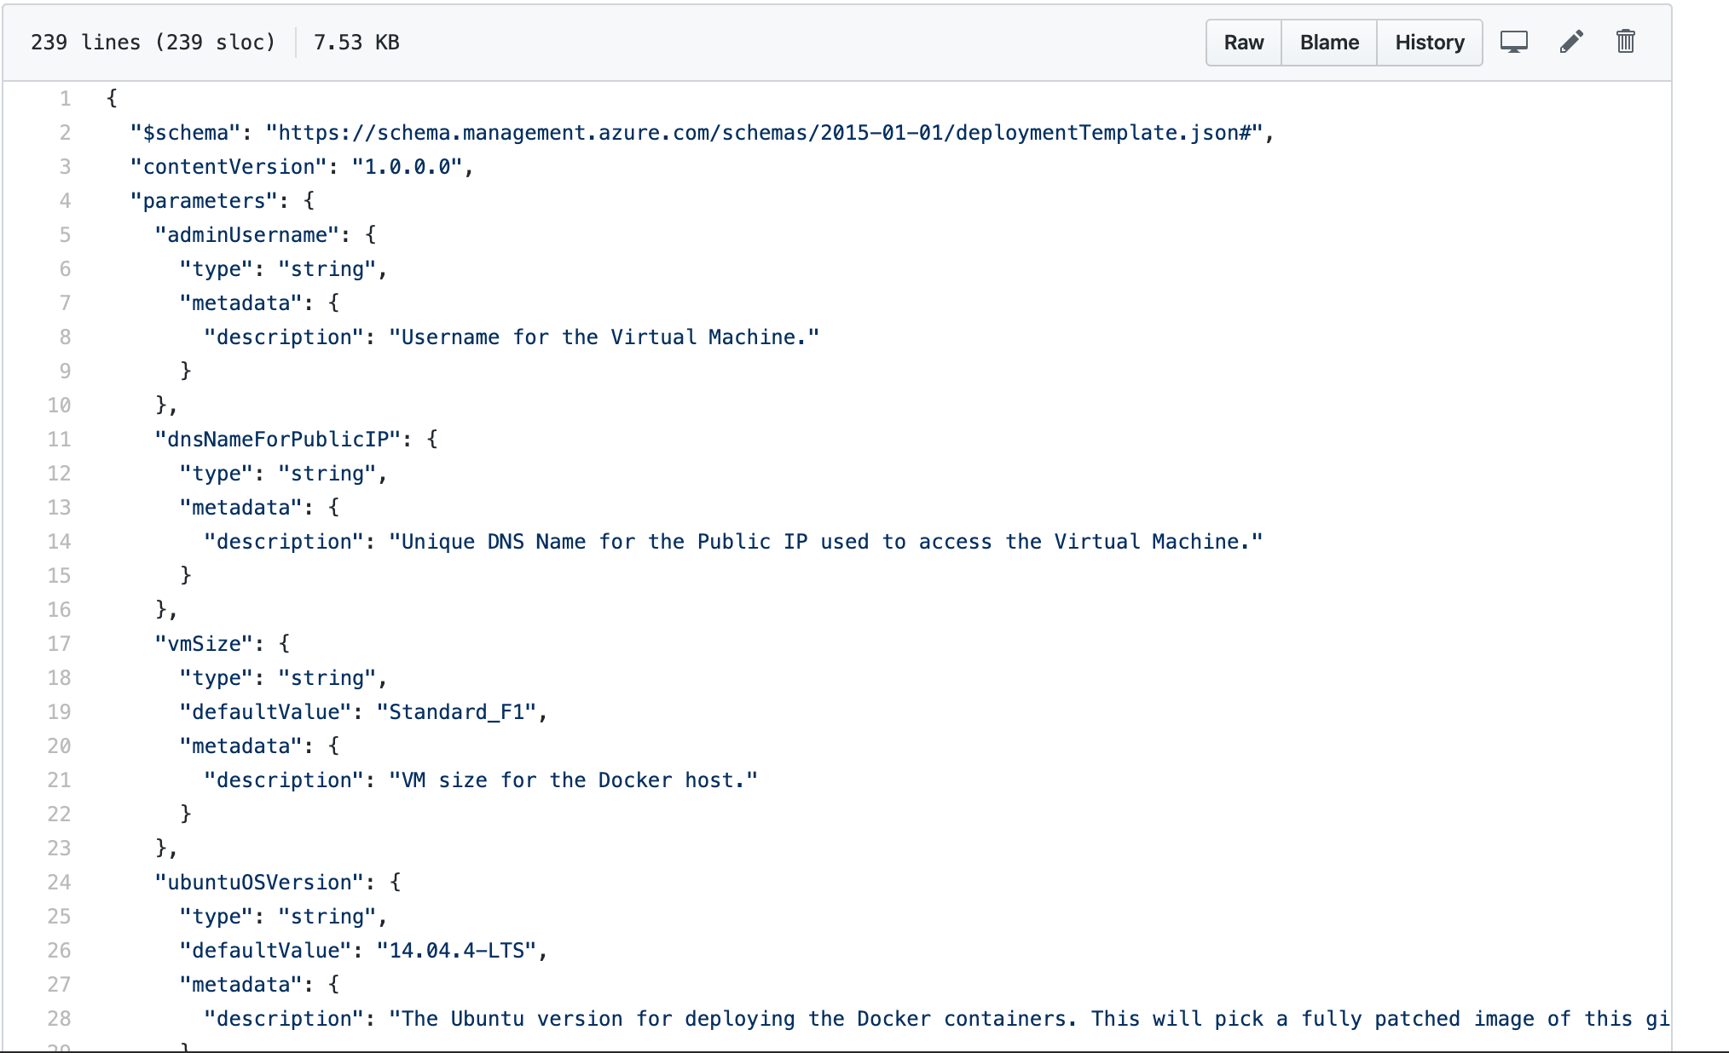
ARM Template https://github.com/Azure/azure-quickstart-templates/blob/master/docker-simple-on-ubuntu/azuredeploy.json

Slide 22
Summary
Automation is increasingly required for increasing demands
Automation can be done in many ways
A formalized approach assists the Automation Process

Slide 23
Thank you

